Slide 1
COMS30043 Games Project
Technical Introduction and Tutorial
Jordan Taylor

Slide 2
Preamble
Sections shall be broken up into what is deemed Essential, Conditional, and Suggested knowledge.
This presentation is designed to be a reference point! You don’t need to take in all the content in-person!
Figures, images, and diagrams are derived from the source code of the following projects:
Insane Ian (UoB 2021 Games Project)
Commodore Mandeville: Revenge of The Martians
Space Quest: 2099
They Came First
Rights to the projects and their assets are wholly owned by Jordan Taylor and may be distributed freely for educational purposes. Links in references.

Slide 3










Slide 4

About Unity
Unity is a cross-platform game engine initially released in 2005.
Unity is general purpose – able to facilitate the creation of 2D and 3D games, simulations, as well as interactive content.
Unity now supports over 20 different target platforms for deploying, so the chances are you’ll be able to deploy to any platform you need.

Slide 5
In This Session:
Essential
Basics of the Unity Engine
Installing Unity
Compatible IDEs
Project settings and environment set-up
Navigation within the editor
GameObjects
Transforms and GameObject Parenting
Component oriented framework
The Camera
Building Your Game

Slide 6
In This Session:
Essential
Interactions within the Unity Engine.
Physics and Rigidbodies
Collisions
Scripting
Prefabs and GameObject Instantiation
Scene Management
Packages and Imports

Slide 7
In This Session:
Essential
Implementation within the Unity Engine.
C# and OOP within Unity
Coroutines
The Console
Performance Profiler
Creating User Interfaces

Slide 8
In This Session:
Essential
Effects within the Unity Engine.
Textures and Materials
Lighting
The Particle System
Audio Sources and Audio Listeners
Animation System (Legacy)

Slide 9
In This Session:
Conditional
Networking within the Unity Engine.
Network architectures
PUN (Photon Unity Networking)
Serialisation
RPCs (Remote Procedure Calls)

Slide 10
In This Session:
Conditional
Advanced Inbuilt Features within the Unity Engine.
Post Processing
Occlusion Culling
Pathfinding and Navigation
Global Illumination and Baked Lighting
Mechanim (Animator)

Slide 11
In This Session:
Suggested
Workflow Suggestions within the Unity Engine.
Unity Files and Version Control

Slide 12
Basics of the Unity Engine
Essential
Section I

Slide 13
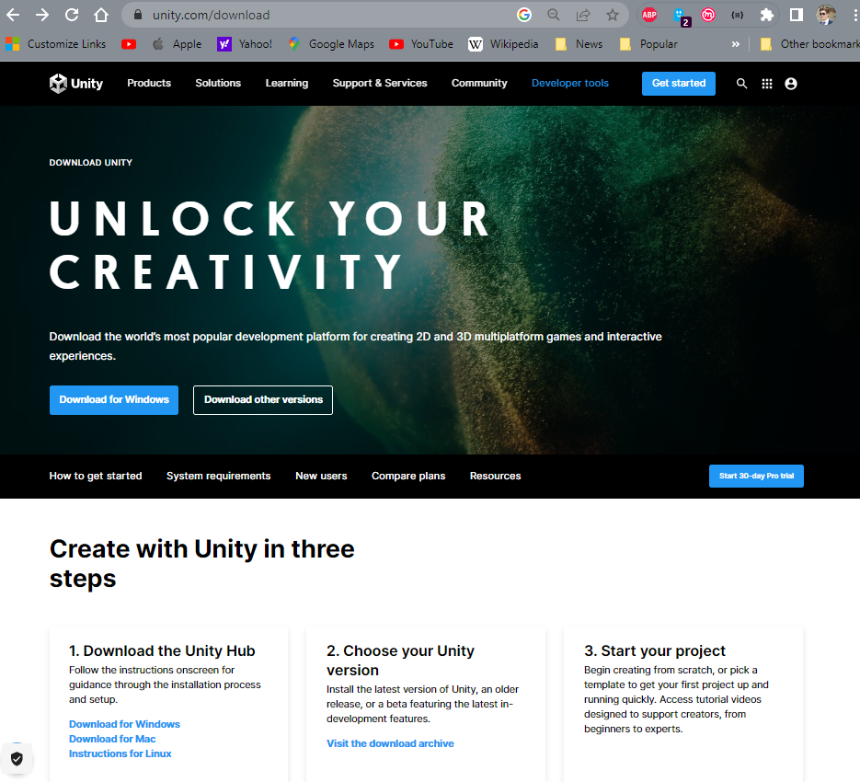
1 – 1: Installing Unity
Essential
Head to unity.com/download

Slide 14
1 – 1: Installing Unity
Essential
Head to unity.com/download
Download the Unity Hub (This lets you manage multiple Unity installations)

Slide 15
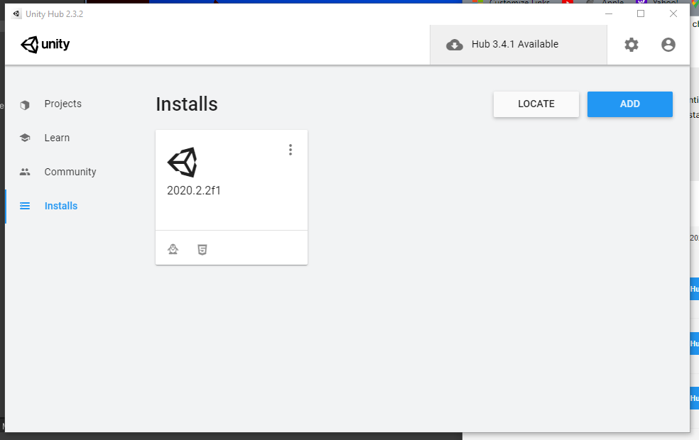
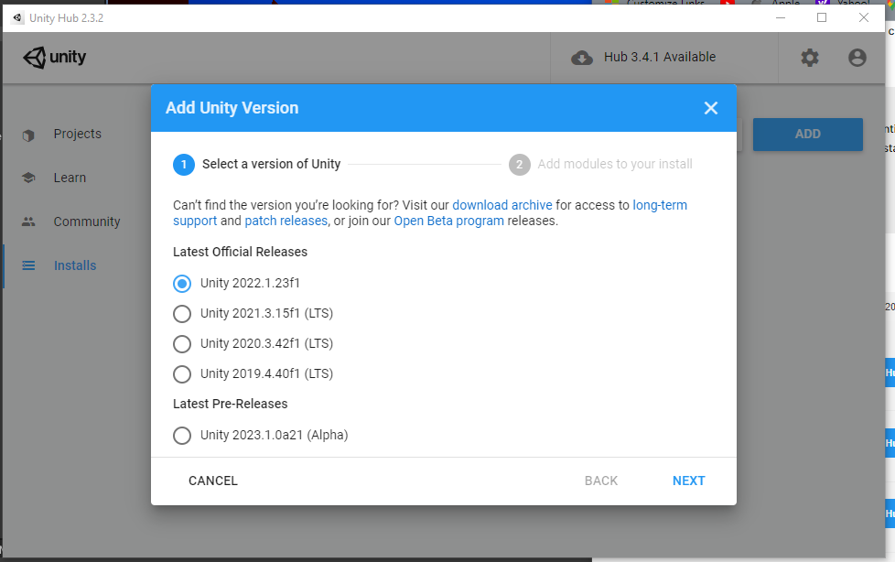
1 – 1: Installing Unity
Essential
Head to unity.com/download
Download the Unity Hub (This lets you manage multiple Unity installations)
Add the most recent stable build of Unity (it is recommended to avoid beta or alpha builds). As of January 2023, this is Unity 2022.1.23f1. Ensure all team members install the same version of Unity!

Slide 16
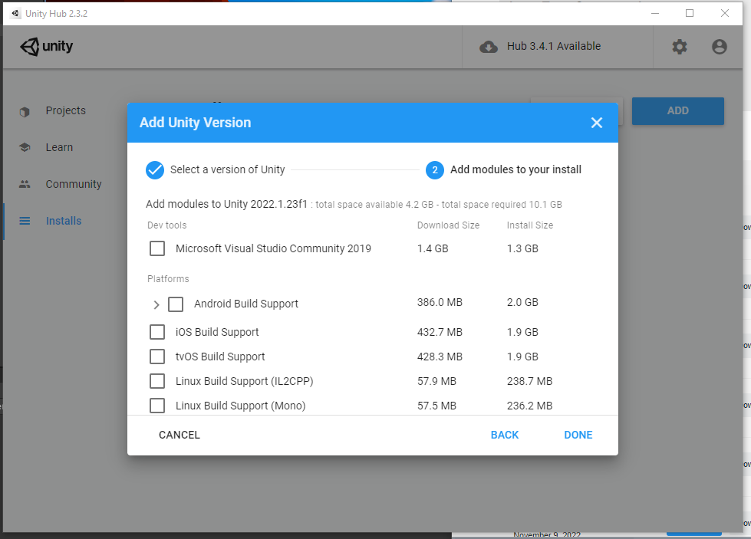
1 – 1: Installing Unity
Essential
Head to unity.com/download
Download the Unity Hub (This lets you manage multiple Unity installations)
Add the most recent stable build of Unity (it is recommended to avoid beta or alpha builds). As of January 2023, this is Unity 2022.1.23f1. Ensure all team members install the same version of Unity!
Select relevant modules to add to your Unity installation. Windows, Mac, Linux, and WebGL build support are recommended.

Slide 17
1 – 1: Installing Unity
Essential
Head to unity.com/download
Download the Unity Hub (This lets you manage multiple Unity installations)
Add the most recent stable build of Unity (it is recommended to avoid beta or alpha builds). As of January 2023, this is Unity 2022.1.23f1. Ensure all team members install the same version of Unity!
Select relevant modules to add to your Unity installation. Windows, Mac, Linux, and WebGL build support are recommended.

Slide 18




1 – 2: Compatible IDEs
Essential
Unity doesn’t play nice with all IDEs. Unity directly supports the following IDEs:
Visual Studio Professional/Community
Visual Studio Code
Jetbrains Rider

Slide 19

1 – 2: Compatible IDEs
Essential
When you install Unity on Windows and macOS, by default Unity also installs Visual Studio. You can choose to exclude it when you select which modules to download and install.
Visual Studio, despite not being a particularly lightweight application, tends to work rather well ‘out the box’, managing required Unity dependencies and packages automatically.

Slide 20
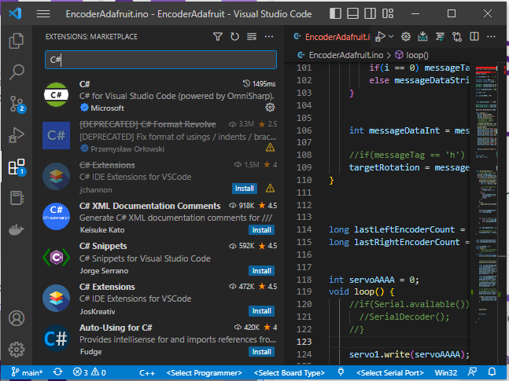
1 – 2: Compatible IDEs
Essential
To use Visual Studio Code for C# code editing and Unity C# debugging support, you need to install:
Mono (only required on macOS and Linux)
Visual Studio Code C# Extension
Visual Studio Code Debugger for Unity Extension
Personally, this is my favourite IDE to use.

Slide 21

1 – 2: Compatible IDEs
Essential
JetBrains Rider has functionality on Windows, MacOS, and Linux.
Rider is based on ReSharper and includes most of its features. It supports all of C# 7.2’s features as well as C# debugging on the .NET 4.6 scripting runtime in Unity.
As such, similar to Visual Studio, it tends to work well out the box.
Despite this, Rider may ask that you register for an educational license or a trial period.

Slide 22
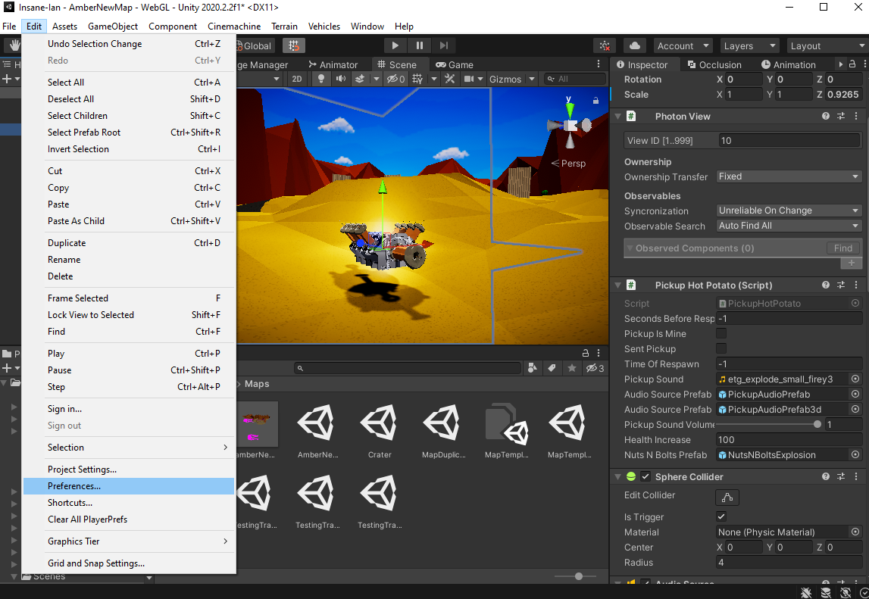
1 – 3: Preferences
Essential
The preferences window allows you to define how you want the Unity editor to behave. These settings are not shared through version control.
To open the Preferences window, go to Edit > Preferences.

Slide 23
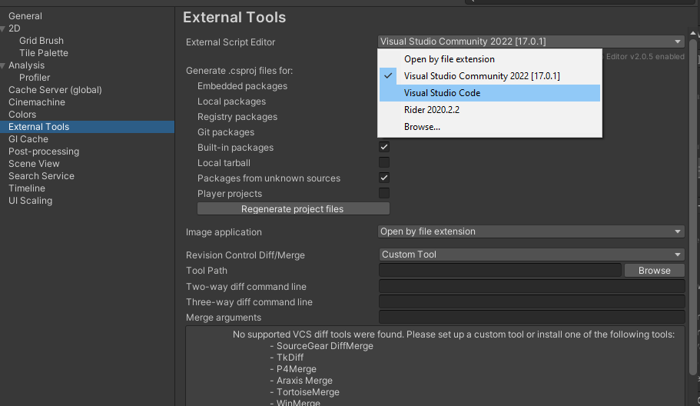
1 – 3: Preferences
Essential
From the preferences window, you are able to perform tasks such as:
Select an external script editor (IDE)
Setting Unity’s colour scheme
Managing the Global Illumination Cache
UI scaling and Accessibility

Slide 24
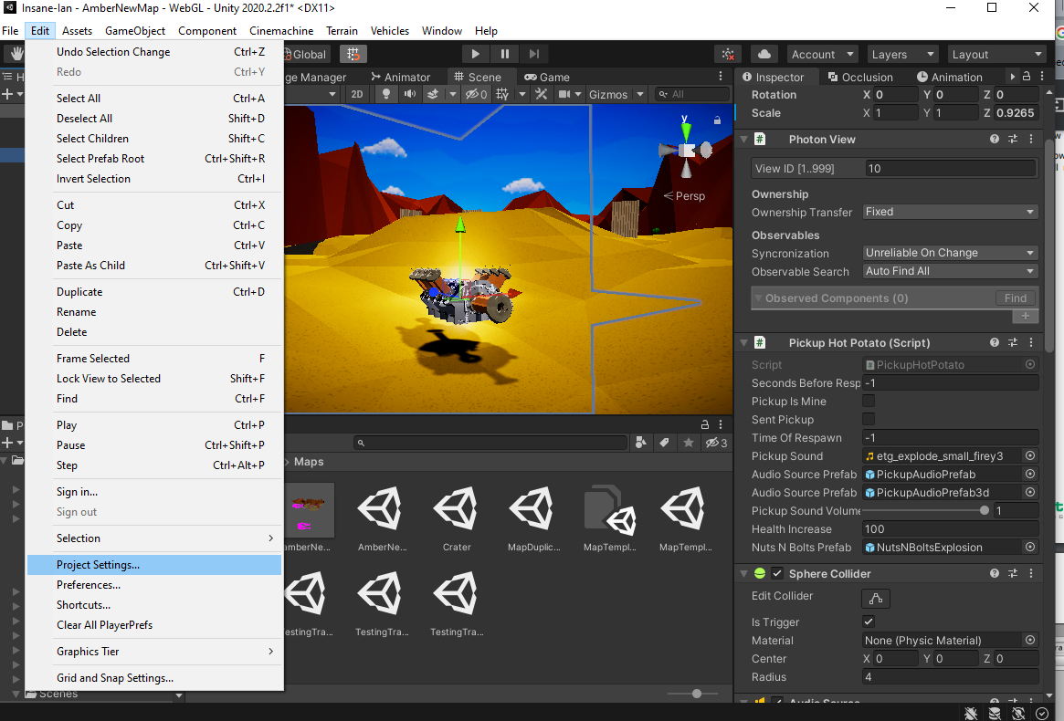
1 – 4: Project Settings
Essential
You may define settings for your project using the Project Settings window.
These settings may be shared with other team members by your version control software, so be mindful!
To open the Project Settings window, go to Edit > Project Settings.

Slide 25
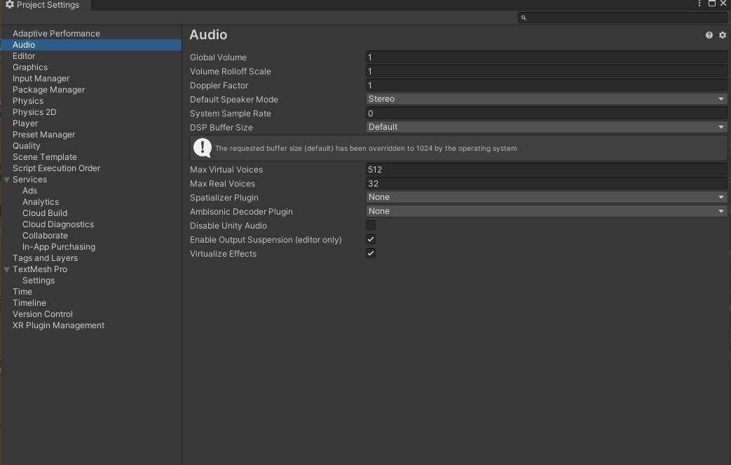
1 – 4: Project Settings
Essential
The Project Settings Window includes controls for:
Adaptive performance
Audio
Graphics and Quality Presets
Physics conditions
Time and game update rates
Input Management (Legacy)
“Player” settings

Slide 26
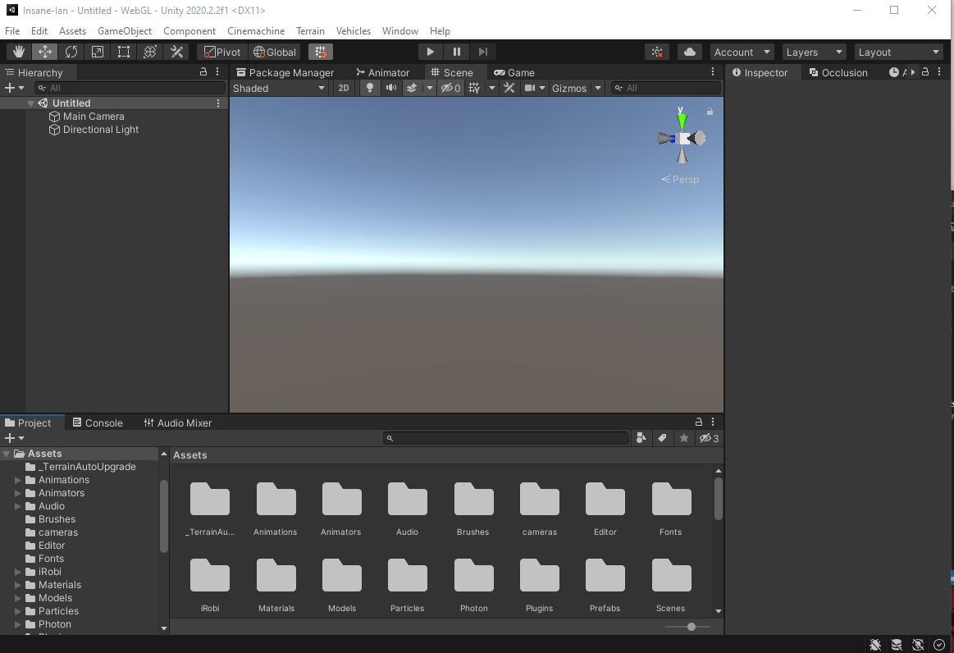
1 – 5: Navigating The Editor
Essential
Upon creating a new project, a screen similar to below should appear:

Slide 27
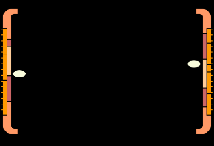

1 – 5: Navigating The Editor
Essential
The highlighted area is called the Scene view. Scenes are analogous to levels – in which all of your game takes place.
It is a 3D space in which your GameObjects are interactable.
GameObjects can be anything from the player’s model to the GUI on the screen, from buttons and enemies to invisible “managers” like sources of sound.
You will be able to drag and position prefabs from the Project view into the Scene view.

Slide 28

1 – 5: Navigating The Editor
Essential
The region on the left is the Scene Hierarchy. It is where all currently existing GameObjects are listed with respect to their parent-child transform relationship, each belonging to and being listed under a scene name.
In our case, that is presently untitled.
Presently, the only GameObjects that can be seen are the Main Camera and a Directional Light

Slide 29
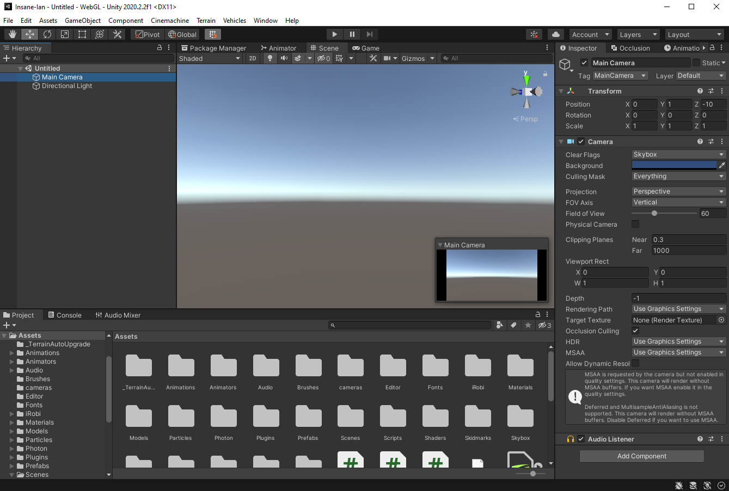


1 – 5: Navigating The Editor
Essential
The region on the right is the Inspector. If we click on the Main Camera GameObject in the Hierarchy, the inspector becomes populated.
Here we can view and edit the name of the GameObject, as well as the Transform, Camera, and Audio Listener Components.
We are also able to add new components.

Slide 30

1 – 5: Navigating The Editor
Essential
You may explore your project directory using the highlighted Project window, normally located below the scene view and hierarchy.
The majority of your project files will be made up of scripts, prefabs, materials and textures.
The example shows Insane Ian Project files.

Slide 31
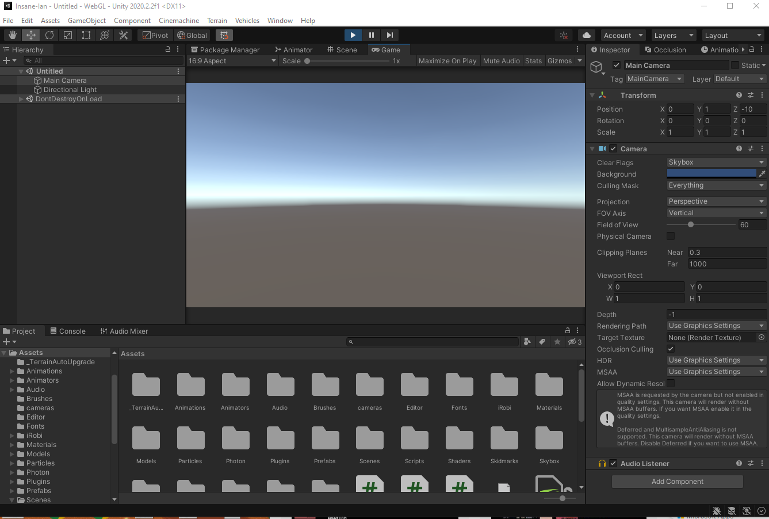
1 – 5: Navigating The Editor
Essential
Selecting the Game window tab and pressing the play button will play an interpreted version of your scene in its current state.
There are no visible objects in the scene, so the Main Camera simply renders the skybox at the horizon.
In this case, the Game view has replaced the Scene view – but this does not have to be the case!
All windows can be dragged around and rearranged – even to separate monitors!

Slide 32
1 – 5: GameObjects
Essential
As mentioned before, a scene is made out of objects, called GameObjects.
GameObjects follow a similar paradigm to Objects in OOP (don’t get confused, objects still exist, we’re not describing code yet!)
GameObjects are instantiations of a base prefab.
GameObjects have a set of components attached to them, which describe how they behave in the scene, as well as how they react to others in the scene.
Everything that exists in your game is a GameObject, and most of your scripting will be writing Monobehaviour components to define their behaviour and interactions.

Slide 33
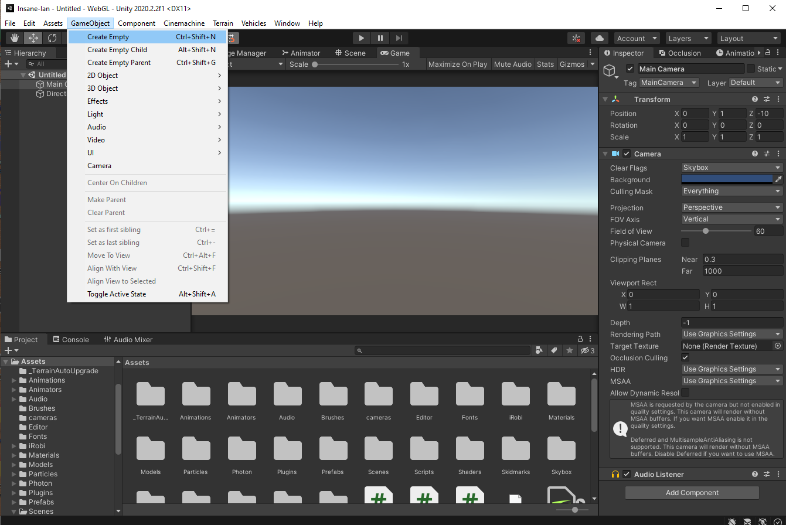
1 – 5: GameObjects
Essential
We can create a new empty GameObject in our Scene View by going to the GameObject tab and selecting ‘Create Empty’.
An empty GameObject exists without any components aside from a Transform, it is simply an entity within the scene.

Slide 34
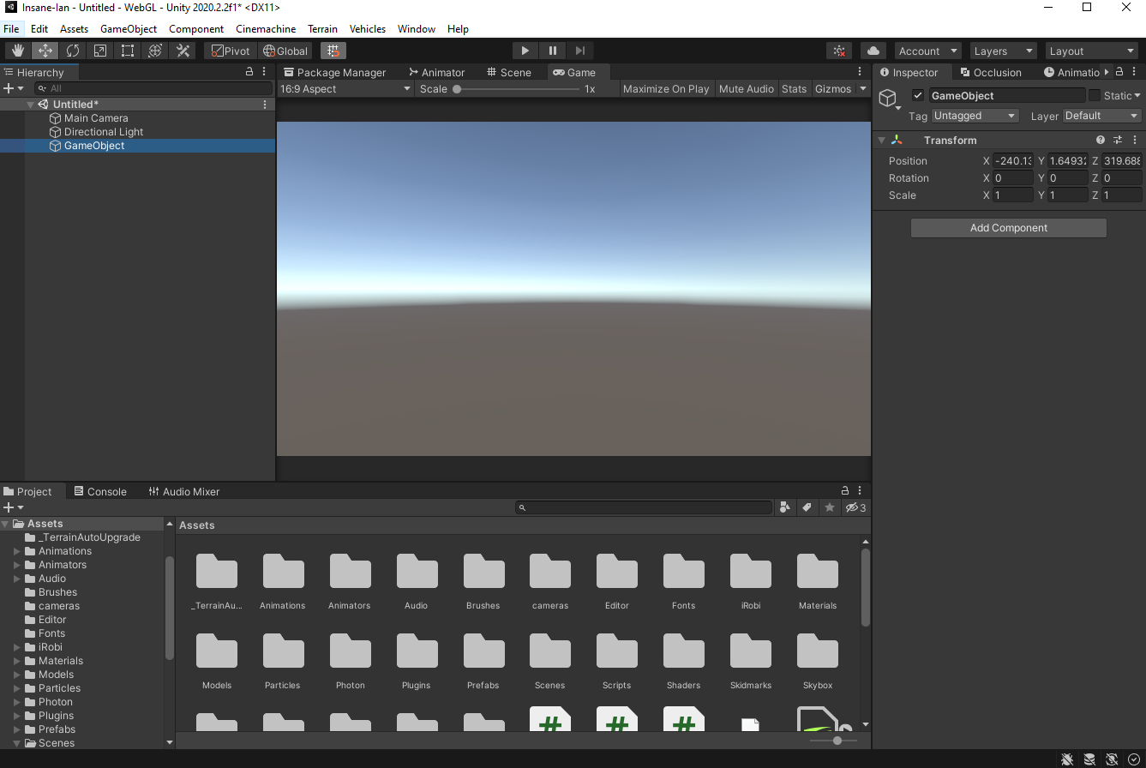
1 – 5: GameObjects
Essential
We can create a new empty GameObject in our Scene View by going to the GameObject tab and selecting ‘Create Empty’.
An empty GameObject exists without any components aside from a Transform, it is simply an entity within the scene.
Here’s an example of an empty GameObject.

Slide 35
1 – 5: GameObjects
Essential
GameObjects may be disabled in-editor or programmatically at runtime.
In editor, this is done with the highlighted checkbox.
This disables the behaviour of almost all components without destroying it.
Note that this does not affect the Awake() method.

Slide 36
1 – 5: GameObjects
Essential
You may Destroy a GameObject programmatically by calling the static Destroy method.

Slide 37

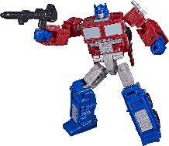
1 – 6: Transforms and Parents
Essential
All GameObjects must have a Transform component.
Transform governs the GameObject’s position, rotation, and scale with respect to its current frame of reference (local or global space).
Rotations are viewed as Euler Angles (x,y,z), but are internally represented as Quaternions.
It is generally recommended that you don’t try and write/set Quaternions yourself, and instead rely on wrapper methods.

Slide 38


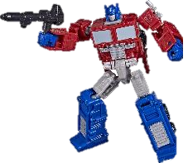
1 – 6: Transforms and Parents
Essential
We are able to ‘parent’ GameObjects to each other.
This can be done in the Hierarchy view, or programmatically at runtime.
A child transform will define itself in the local space of its parent, rather than in world space.
This means that it moves, rotates, and scales as if it were a part of the parent.

Slide 39
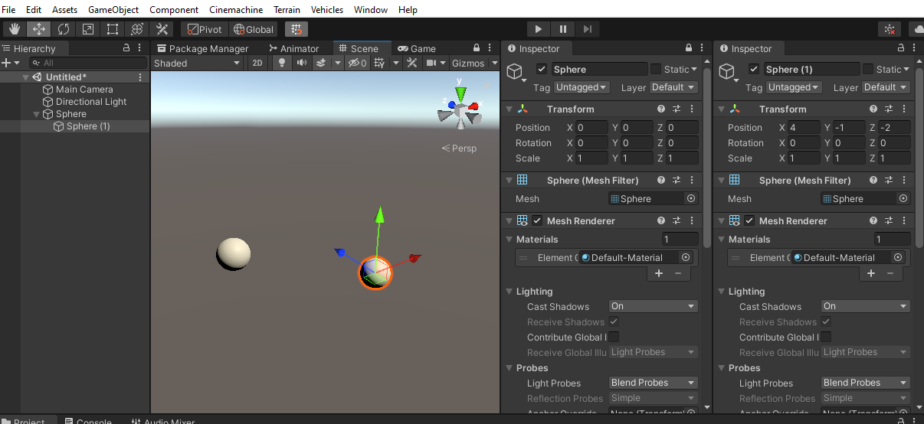
1 – 6: Transforms and Parents
Essential
Parent:
Child:
Notes:
We are able to ‘parent’ GameObjects to each other.
This can be done in the Hierarchy view, or programmatically at runtime.
A child transform will define itself in the local space of its parent, rather than in world space.
This means that it moves, rotates, and scales as if it were a part of the parent.

Slide 40
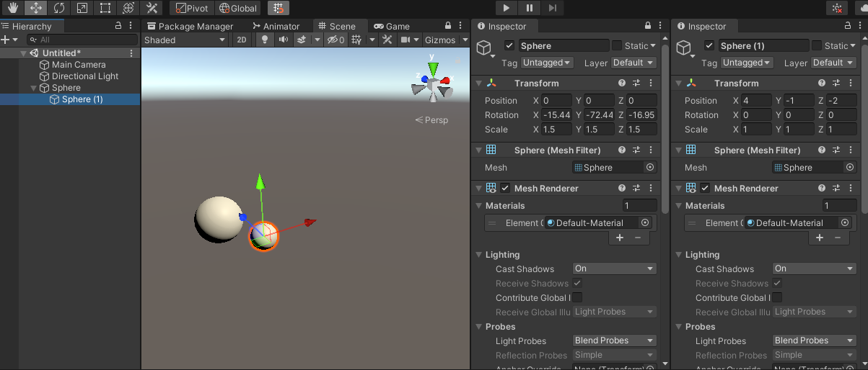
1 – 6: Transforms and Parents
Essential
Rotated Parent:
Child:
Child position and rotation do not change!
This is because the child remains in Local Space.
Notes:
We are able to ‘parent’ GameObjects to each other.
This can be done in the Hierarchy view, or programmatically at runtime.
A child transform will define itself in the local space of its parent, rather than in world space.
This means that it moves, rotates, and scales as if it were a part of the parent.

Slide 41
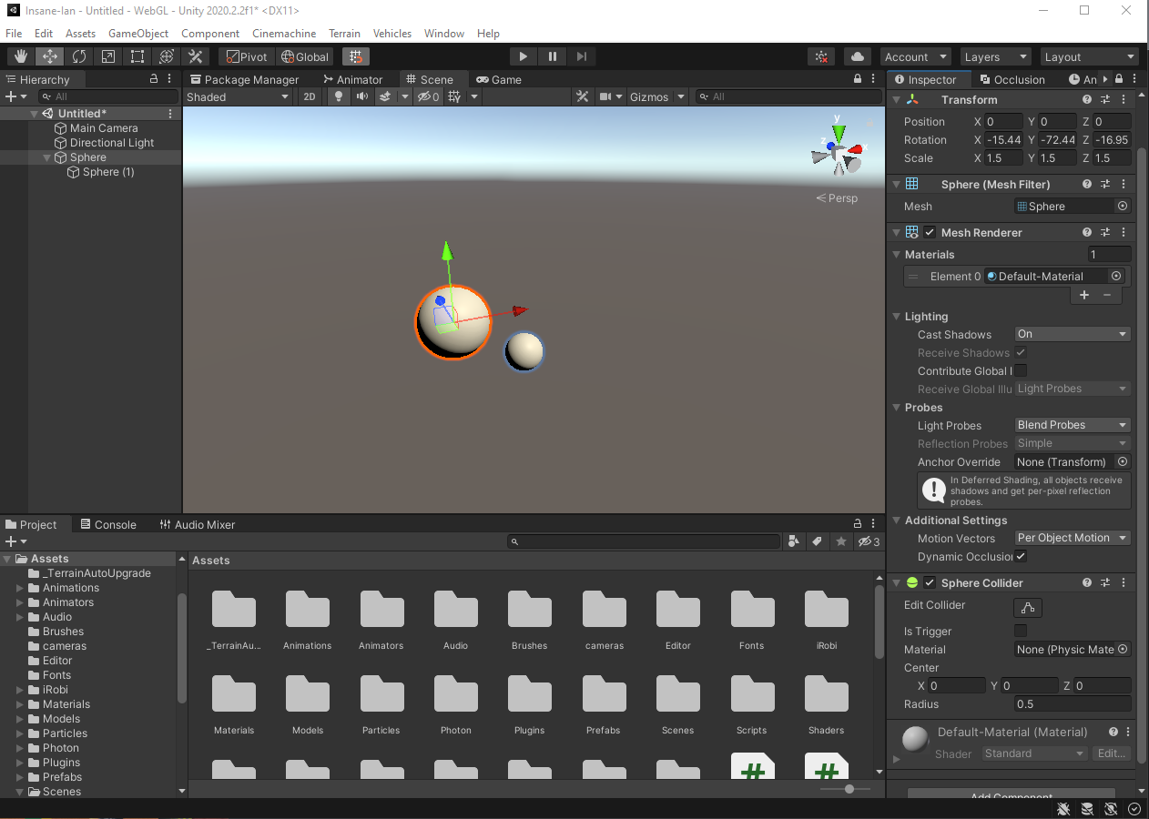
1 – 7: Components
Essential
Let’s take a look at our sphere GameObject.
We can see that it has a Transform, Mesh Renderer, Mesh Filter, and Sphere Collider (as well as subcomponent Material belonging to Mesh Renderer).

Slide 42
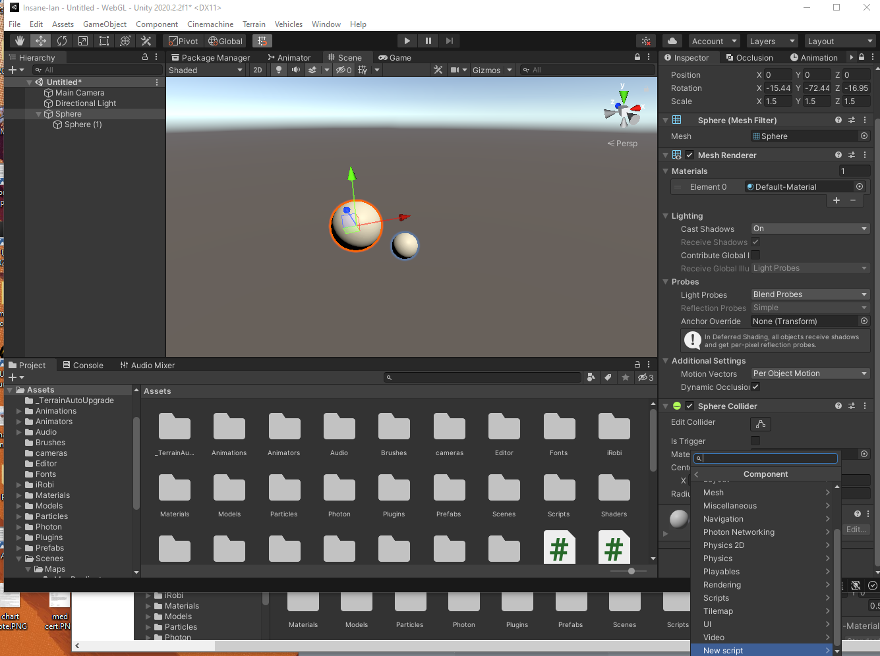
1 – 7: Components
Essential
Let’s take a look at our sphere GameObject.
We can see that it has a Transform, Mesh Renderer, Mesh Filter, and Sphere Collider (as well as subcomponent Material belonging to Mesh Renderer).
We can add more components, including our own defined Monobehaviours.

Slide 43
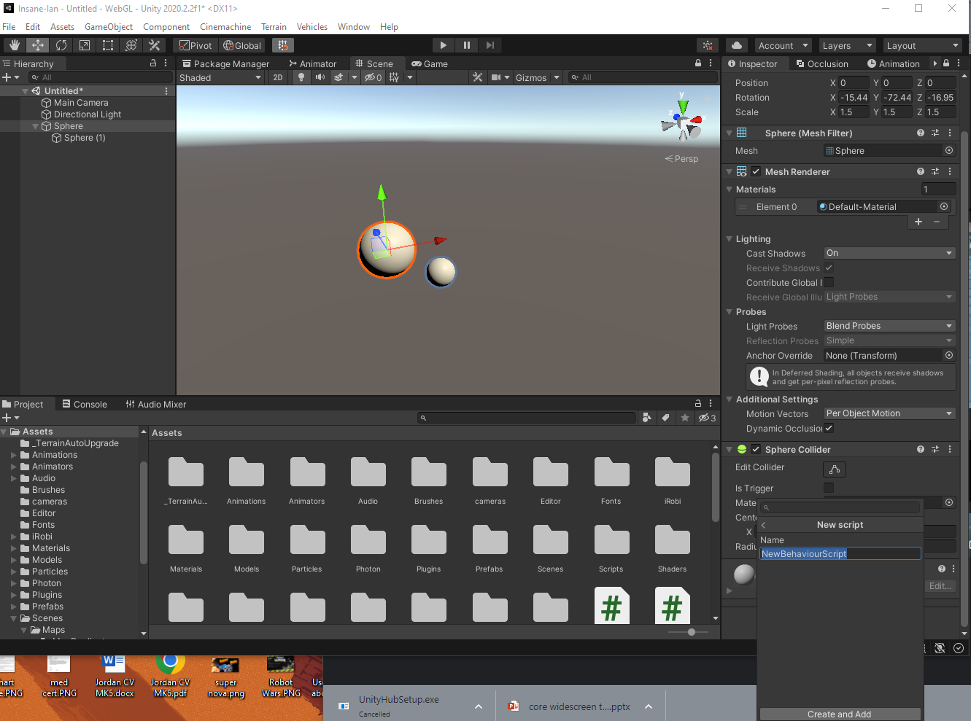
1 – 7: Components
Essential
Let’s take a look at our sphere GameObject.
We can see that it has a Transform, Mesh Renderer, Mesh Filter, and Sphere Collider (as well as subcomponent Material belonging to Mesh Renderer).
We can add more components, including our own defined Monobehaviours.

Slide 44


1 – 7: Components
Essential
Note that we can also drag scripts from the project view.
Scripts have the # icon.

Slide 45
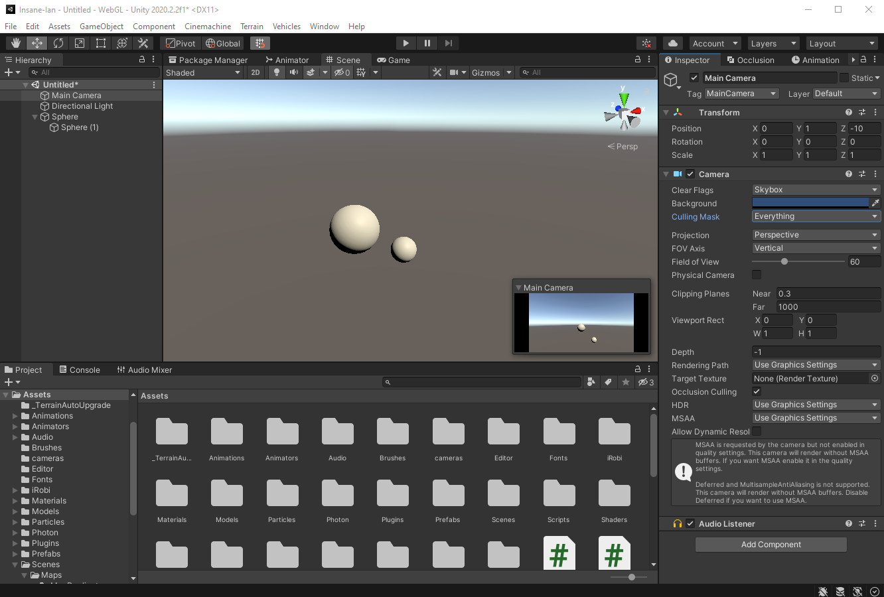
1 – 8: Camera
Essential
The Camera is the view through which you are able to view the Game World.
By default this is the Main Camera (with Tag Main Camera), with a culling mask over all layers. This means that the camera can view everything.
It is possible to switch between cameras by disabling the camera component on all other camera instances at runtime.

Slide 46
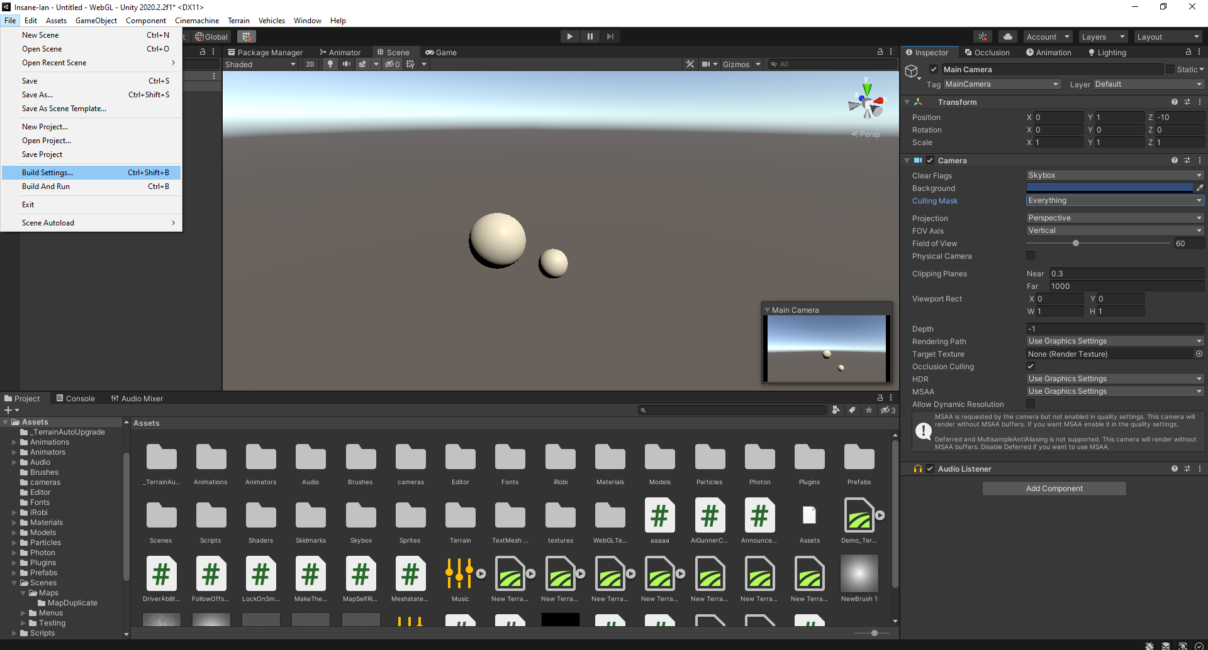
1 – 9: Building Your Game
Essential
To build your game means to compile and export it standalone to a target platform.
You’ll need to do this, Tilo won’t be very happy if you can only run your game in-editor.
Navigate to File -> Build Settings to begin the process

Slide 47
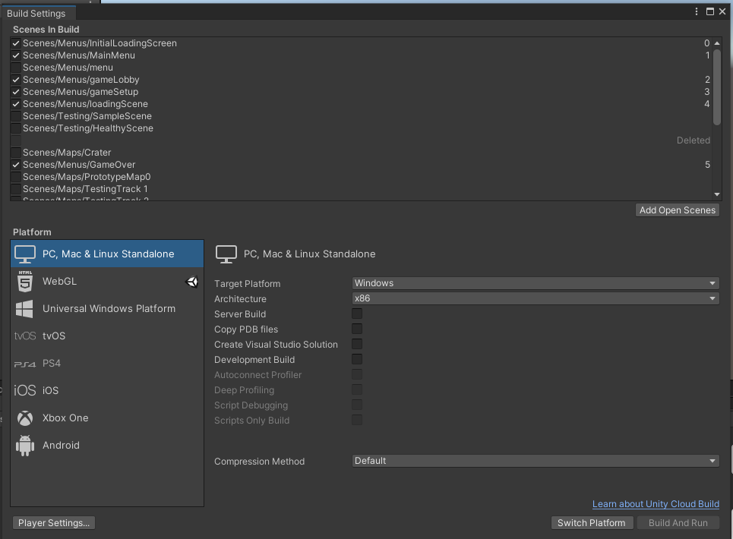
1 – 9: Building Your Game
Essential
In the build setting menu, you can see all the scenes currently in your game, determined from your project files.
Target platform may be chosen here, as well as architecture.
The little unity logo shows which platform your project is currently configured for.

Slide 48
Interactions within the Unity Engine
Essential
Section II

Slide 49
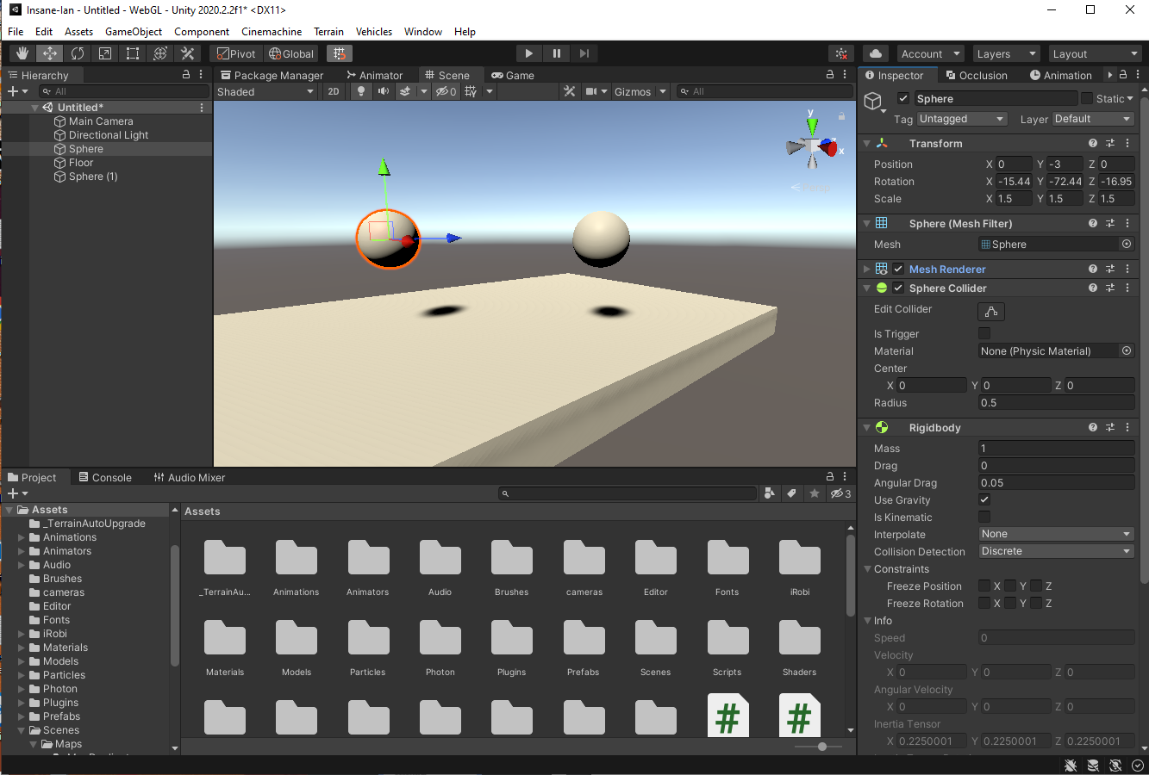
2 – 1: Understanding Collisions
Essential
When we consider every component as a GameObject, we realise that there could be thousands of GameObjects in a scene, interacting with each other in some way.
Computing every collision would introduce a huge amount of computational overhead.
Not all GameObjects need to be collidable!

Slide 50
2 – 1: Understanding Collisions
Essential
When we consider every component as a GameObject, we realise that there could be thousands of GameObjects in a scene, interacting with each other in some way.
Computing every collision would introduce a huge amount of computational overhead.
Not all GameObjects need to be collidable!
As such, collisions occur between Gameobjects with collider components, with one or more collision participants requiring a rigidbody.
Colliders come in multiple types, including Box, Sphere, and Mesh – all inheriting from the base Collider class.

Slide 51
2 – 2: Rigidbodies
Essential
Rigidbodies are components that allow a GameObject to react to real-time physics. This includes reactions to forces and gravity, mass, drag and momentum.
The Is Kinematic defines whether other rigidbodies are able to interact with its own physics.
The enumerated interpolate field pertains to how the object should behave with different physics timestep update rates.
There are two key game ticks in Unity:
Framerate and fixed update.

Slide 52
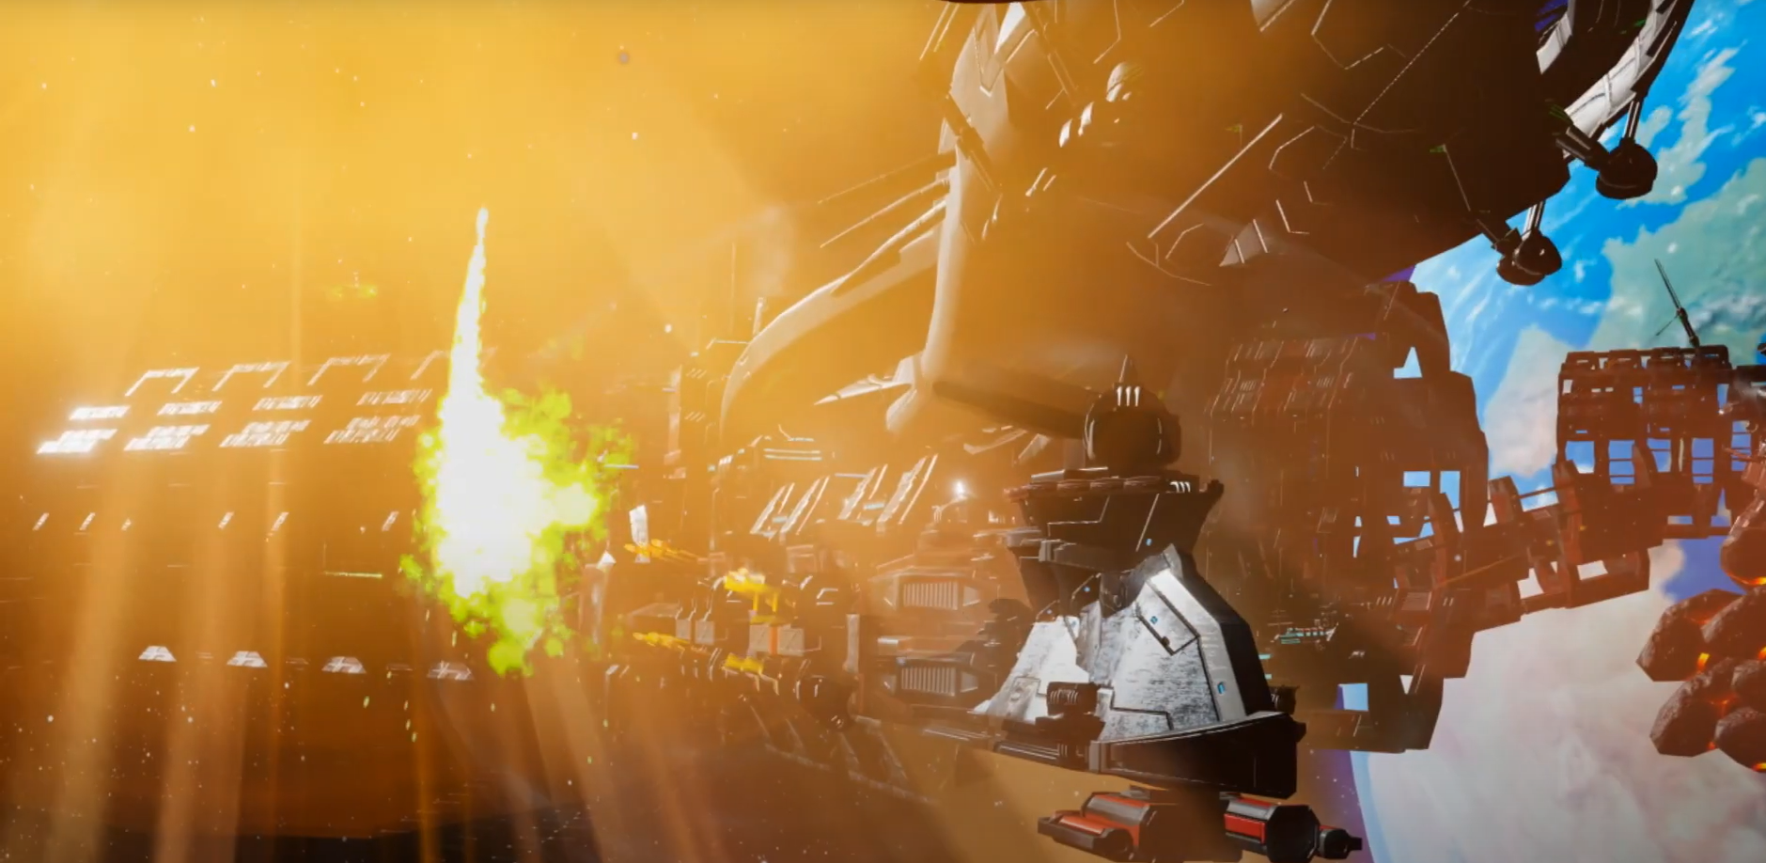
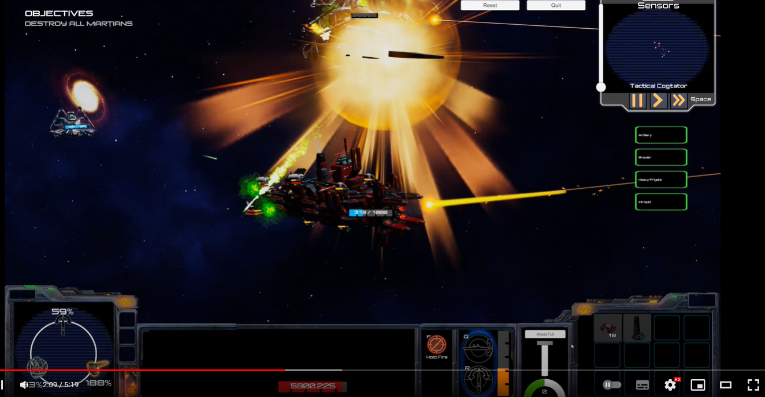
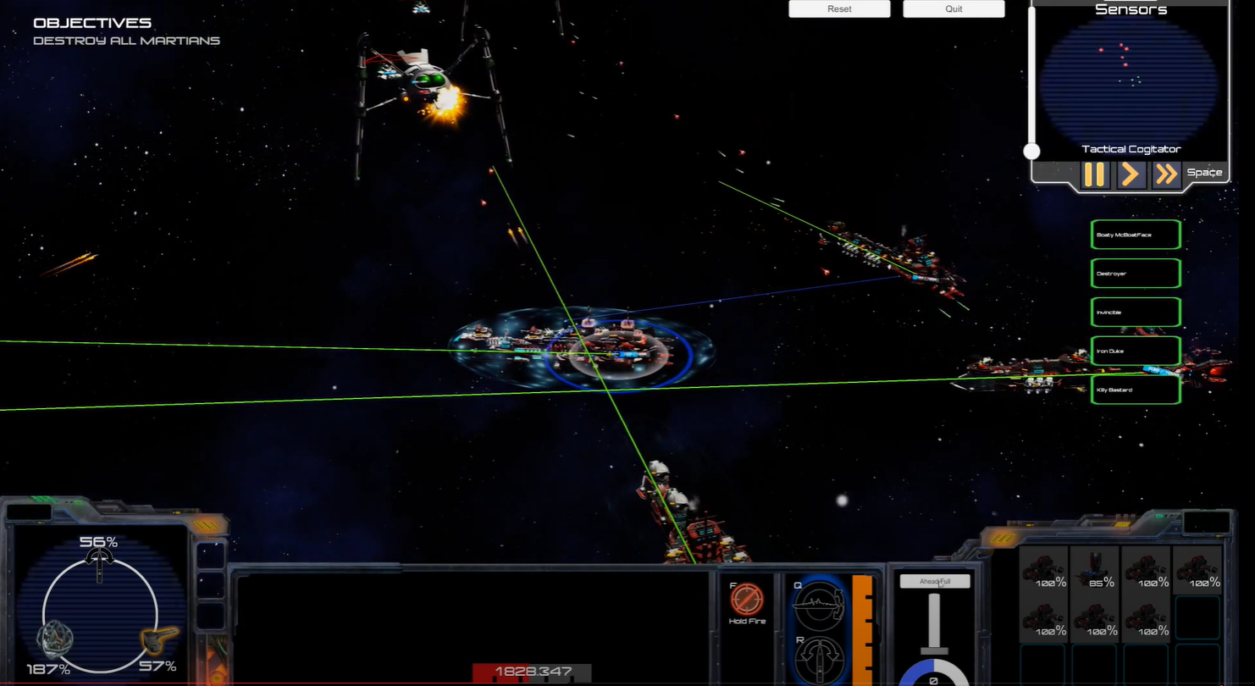
2 – 2: Rigidbody interpolation example
Conditional
Projectiles in Commodore Mandeville: Revenge of The Martians had to make use of interpolated rigidbodies.
RoTM is a Strategy game that featured the ability to slow down time while issuing orders.
Game simulation would run at a different update rate to physics update rate, leading to choppy moving projectiles and ships during ramming actions.
Rigidbody interpolation updates the perceived transform of the object independent of the physics engine between physics updates each frame.

Slide 53
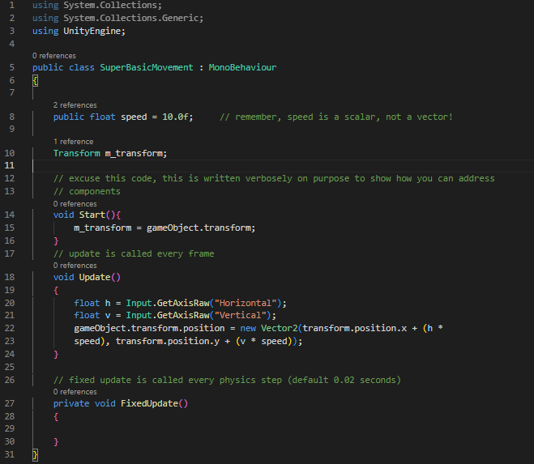


2 – 3: Scripting
Essential
You may attach scripts to GameObjects if they are of the type Monobehaviour.
As an example, let’s have a look at a very basic 2D movement script:

Slide 54
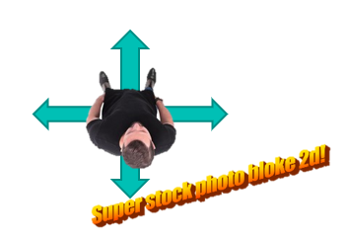
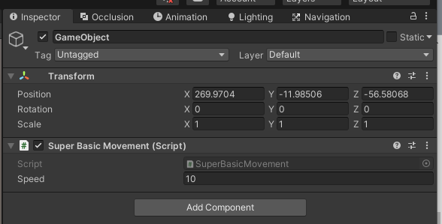
2 – 3: Scripting
Essential
We can see our Monobehaviour component in the inspector, after it has been attached to an empty GameObject.
‘SuperBasicMovement’ inherits from Monobehaviour.

Slide 55
2 – 3: Scripting
Essential
In the inspector, the public attribute ‘speed’ is visible.
This allows us to edit the default value of the variable in-editor without changing the code.
A Monobehaviour may reference its host GameObject by simply stating ‘gameObject’.
The transform of a GameObject can be referenced by simply stating ‘transform’.

Slide 56
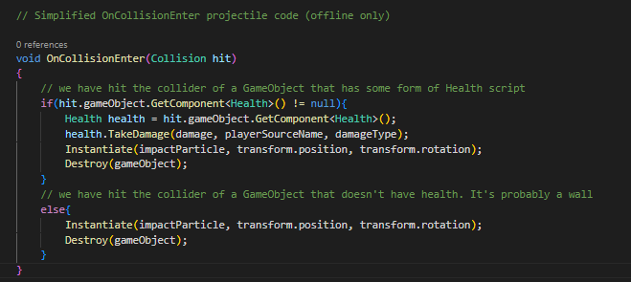
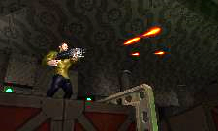
2 – 3: Scripting – Multiple Scripts
Essential
It is possible to call methods on other script components, so long as the methods are declared as public.
In this example, we look at a simple potential implementation of a projectile hitting a collider and dealing damage if it has an attached Health script.
Method called on collision
This may be polymorphic!
Check if hit object has Health component
Get reference to Health component
Call method ‘TakeDamage’ on Health
projectile

Slide 57
2 – 4: Prefabs
Essential
Unity’s Prefab system allows you to create, configure, and store a GameObject complete with all its components, property values, and child GameObjects as a reusable Asset.
Any edits that you make to a Prefab Asset are automatically reflected in the instances of that Prefab, allowing you to easily make broad changes across your whole Project without having to repeatedly make the same edit to every copy of the Asset.
Let’s continue with our projectile example…

Slide 58
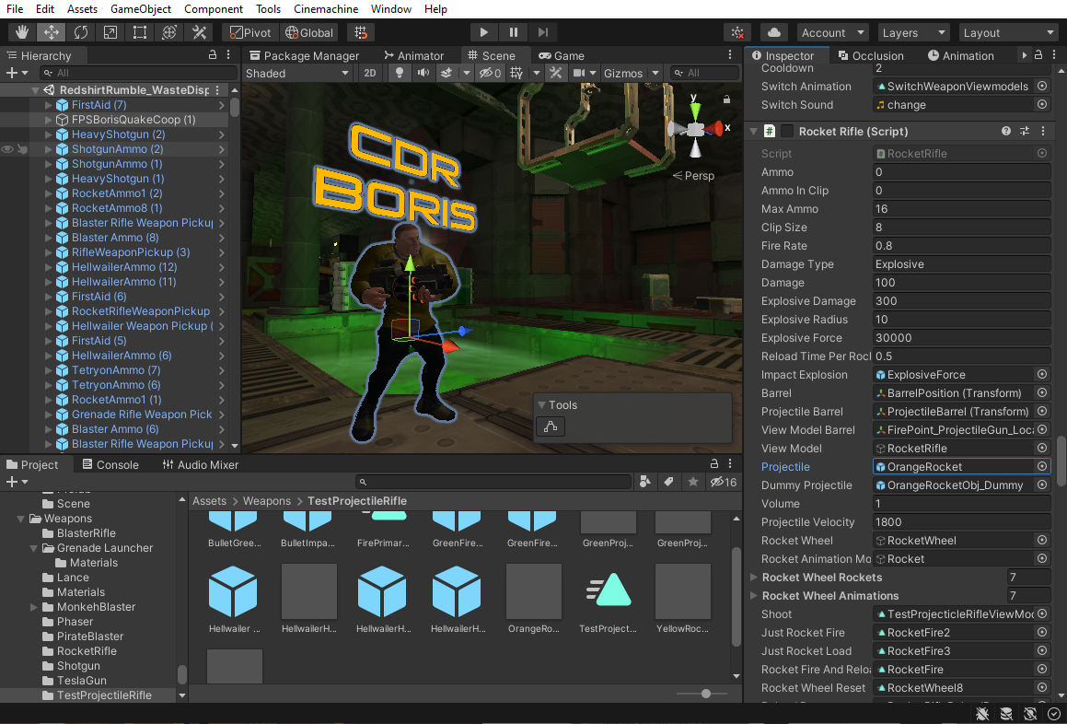
2 – 4: Prefabs
Essential
Continuing with our example, projectiles fired at runtime would be GameObject instances of a Prefab.
Boris may fire orange coloured rockets using his rocket rifle.
The Monobehaviour ‘Rocket Rifle’ has a public GameObject field ‘Projectile’. This may take a rocket Prefab object that has already been defined and saved to the project directory.

Slide 59
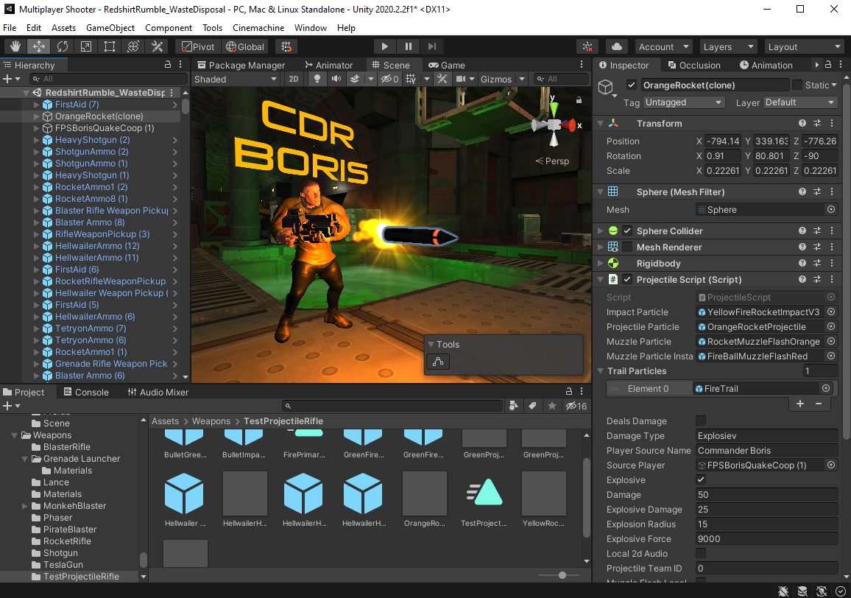
2 – 4: Instances
Essential
When Boris fires his Rocket Rifle, an ‘OrangeRocket’ GameObject is instantiated at the weapon’s barrel position – defined by a Transform.
The rocket’s properties have been defined by its original prefab.
The rocket has been named as a clone, as seen in the Hierarchy – a Unity convention to denote GameObjects instantiated at runtime.

Slide 60
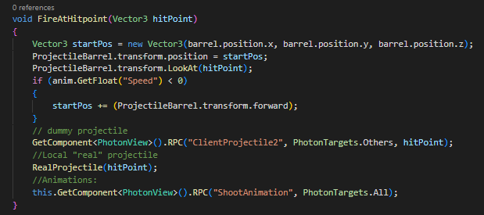
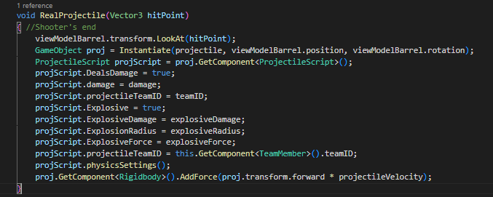
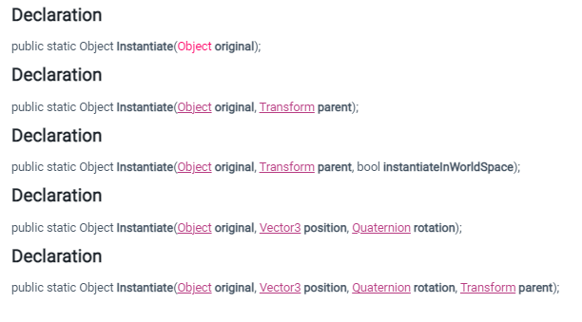
2 – 4: Instantiation
Essential
This rocket projectile was instantiated by code.
The example code is written in the context of a multiplayer game. For now, we are only interested in the ‘real’ projectile.
Given a Vector3 hitpoint, describing a position in world space, a projectile is fired from the player’s barrel to the target position.
This example is shows only one context for the use of the instantiate method. You’ll use it all over the place!

Slide 61
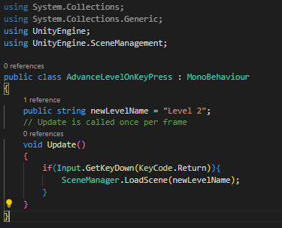
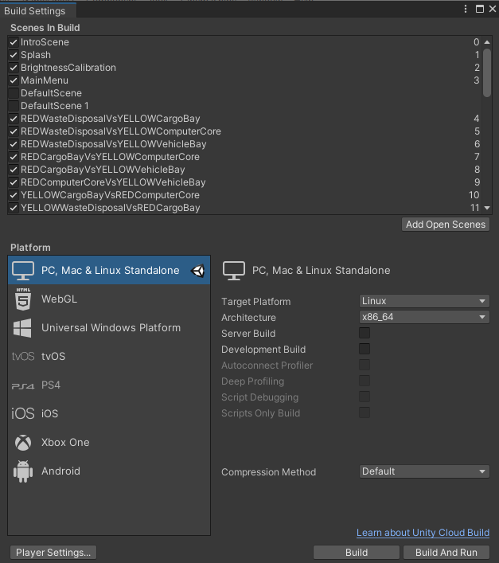
2 – 5: Scene Management
Essential
You’ll need to change scenes in your game.
Recall that scenes are saved to your project directory as .unity files.
The UnityEngine.SceneManagement library is used to handle this.
The example code will load the scene “Level 2”, provided that it has been added to the build settings (File -> Build Settings).
Be aware that scenes may also be loaded asynchronously using a coroutine. This can be useful when you need a smooth scene transition, or when you need to ensure that all players change scene at the same time.

Slide 62
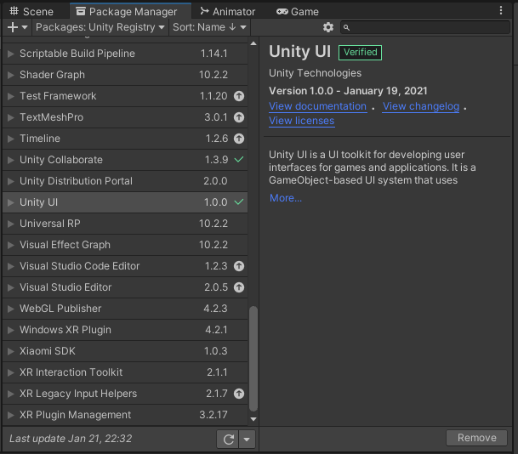
2 – 6: Packages and Imports
Essential
The Unity Editor features a built in package manager for installing packages found on the asset store. These can include official Unity technologies (such as post-processing or Cinemachine), as well as 3rd party technologies.
The package manager is a window.
You can define your own packages within Unity, as well as import packages externally without the use of the package manager.
Unity manages such packages with their own file format which is managed by the editor, allowing you to choose which features you want to import using a checkbox GUI.

Slide 63
Implementation within the Unity Engine.
Section III

Slide 64
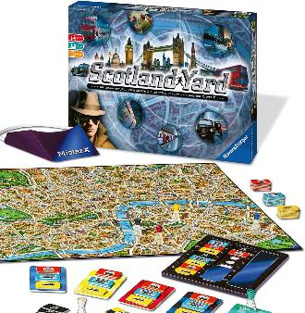
3 – 1: C# and OOP within Unity
Essential
The scripting language used in Unity is C#.
C# supports object oriented programming!
As such, you should remember principals such as polymorphism, encapsulation, and inheritance.
We already know that for a script to be a component, it must inherit from the Monobehaviour class.

Slide 65
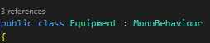
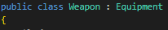
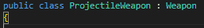
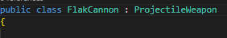
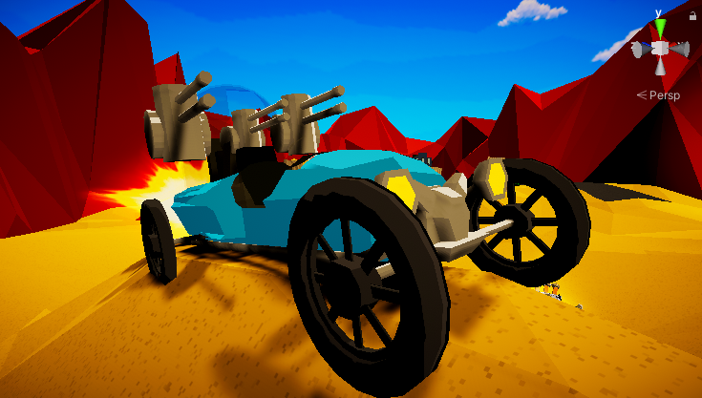
3 – 1: C# and OOP Example
Essential
The weapon system in Insane Ian made extensive use of inheritance and polymorphism.
An example of this is The Spitfire’s Flak Cannon.
Advantages of OOP include:
Modularity
Reusability
Easily Upgradable
Enables the use of Interfaces
Flak Cannon
The Spitfire

Slide 66
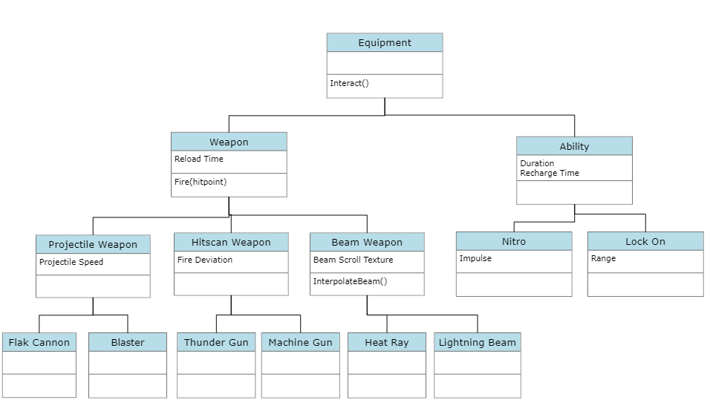
3 – 1: C# and OOP Example
Essential

Slide 67
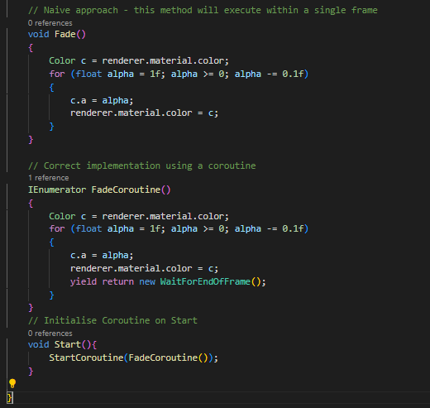
3 – 2: Coroutines
Essential
A coroutine allows you to spread tasks across multiple frames.
In Unity, a coroutine is a method that can pause execution and return control to Unity but then continue where it left off on the following frame.
However, it’s important to remember that coroutines aren’t threads. Synchronous operations that run within a coroutine still execute on the main thread.

Slide 68


3 – 3: Debug Logs and The Console
Essential
Good news! Unity has a console! This means you can be lazy and use print statements as a debugging tool!
We use the Debug.Log line to print to the console.
Similar messages can be collapsed by clicking the ‘collapse’ flag.

Slide 69

3 – 4 The Performance Profiler
Essential
The Unity Profiler is a tool you can use to get performance information about your application.
You can connect it to devices on your network or devices connected to your machine to test how your application runs on your intended release platform.
You can also run it in the Editor to get an overview of resource allocation while you’re developing your application.
You will be judged on your game’s performance, so make sure it runs well!
To access the Profiler window go to menu: Window > Analysis > Profiler

Slide 70

3 – 5 Creating GUIs in Unity
Essential
User interfaces, including menus and HUDs (Heads up displays) can be quickly assembled within the Scene View.
Navigate to GameObject -> UI -> Canvas to get started
Canvas GameObjects project their contents in 2D as an overlay to the game view – independent of lighting and postprocessing.

Slide 71

3 – 5 Creating GUIs in Unity
Essential
Once created, I recommend setting the Canvas Scaler component to ‘scale with screen size’ for most applications.
To add UI elements to the canvas, create new GameObjects as a child of the Canvas’ Transform in the Hierarchy view.
These objects should have UI components attached.
To access these components programmatically, ensure that you have imported UnityEngine.UI to your script.
Components include

Slide 72
FX in the Unity Engine
Section IV

Slide 73
FX in the Unity Engine
Section IV
(Don’t worry, this is the last of the essential content)

Slide 74

4 – 1 Textures
Essential
Unity is pretty robust at applying textures to objects.
All Unity primitive shapes are already texture mapped (Cubes, Cylinders, Spheres etc…).
For your own models, you may need to set up a texture map in your 3D modelling software.
Textures can be in almost any standard image file format.
For this example, we will be using a .jpg file: Wall03.jpg

Slide 75

4 – 1 Textures and Materials
Essential
We can simply click and drag the texture to the object to apply it.
In doing so, a Material has automatically been created.
This is because Unity does not directly apply textures to an object – it must be done through a Material.

Slide 76

4 – 1 Textures and Materials
Essential
We can simply click and drag the texture to the object to apply it.
In doing so, a Material has automatically been created.
This is because Unity does not directly apply textures to an object – it must be done through a Material.
Materials are their own separate entity and are saved as files.
Multiple materials may share a the same texture.
There are a multitude of Shaders that may be applied to materials.
Matthew is good at these!

Slide 77

4 – 2 Lighting (Realtime)
Essential
Broadly speaking, lighting in Unity can be considered as either realtime or precomputed (baked).
Both techniques can be used in combination to create immersive scene lighting.
Realtime lighting is the most basic way of lighting objects within the scene. It is useful for illuminating movable geometry.

Slide 78
4 – 2 Lighting (Realtime)
Essential
Broadly speaking, lighting in Unity can be considered as either realtime or precomputed (baked).
Both techniques can be used in combination to create immersive scene lighting.
Realtime lighting is the most basic way of lighting objects within the scene. It is useful for illuminating movable geometry.
Real time rays from light sources do not bounce!
Realtime lighting is relatively computationally expensive!
We can add a Light Component to any GameObject.
Lights may act as point lights, spotlights, and directional lights (analogous to Sunlight)

Slide 79


4 – 2 Lighting (Realtime)
Essential
We can add a Light Component to any GameObject.
Lights may act as point lights, spotlights, and directional lights (analogous to Sunlight)
Intensities greater than 1 may be used to facilitate HDR Bloom in Postprocessing.
Similar to the camera, we are able to exclude certain layers from interacting with the light source through the use of a culling mask.
Shadows may be disabled to help with performance / alter aesthetics.

Slide 80

4 – 3 The Particle System
Essential
Looking closer at our example, the Blue Teleporter Portal is an implementation of Unity’s Particle System.
The Blue Portal is a GameObject with attached Particle System Component, and multiple child GameObjects each with their own attached Particle System, as well as a blue point light.
This is a way of compositing particle effects to create the desired FX.
Let’s look at one of the child’s particle systems for a simpler use case.

Slide 81

4 – 3 The Particle System
Essential
The rest of the particle systems have been disabled, leaving only the glowing blue particles as our example.
We can see that this is a looping particle emission with an emission rate of 65 particles per second.

Slide 82

4 – 3 The Particle System
Essential
The rest of the particle systems have been disabled, leaving only the glowing blue particles as our example.
We can see that this is a looping particle emission with an emission rate of 65 particles per second.
We can define the shape of the particle emitter. The blue particles are emitted along the top edge of a truncated cone – at an angle of 60 degrees about a radius of 2.

Slide 83

4 – 3 The Particle System
Essential
The rest of the particle systems have been disabled, leaving only the glowing blue particles as our example.
We can see that this is a looping particle emission with an emission rate of 65 particles per second.
We can define the shape of the particle emitter. The blue particles are emitted along the top edge of a truncated cone – at an angle of 60 degrees about a radius of 2.
The particle itself uses a Material – taking a texture defined by a transparent image and applying a relevant Particle Shader.
In our case, this is ‘bigglow_blue’ using ‘Legacy Shaders/ Particles / Additive Soft’

Slide 84

4 – 4 Audio
Essential
Audio is played in Unity through AudioSource components.
AudioSources are capable of playing sound in 2D and 3D, as well has having controls for volume falloff and the doppler effect.
A 3D sound can be heard with direction if the user has a capable sound system.
For audio to be heard, you will need an AudioListener component to exist in your scene.
To avoid funky 3D audio anomalies, ensure that there is only a single AudioListener in your scene.
AudioSources can be used for sound effects and music. They must be given a valid audio file as AudioClip.
Audio Listener
Audio Source

Slide 85



4 – 4 Animation (Legacy)
Essential
The Legacy Animation System is a simple yet robust way to define an interpolated variable change over a given period, such as a GameObject’s position.
You might think this would only apply to Transforms, but you’d be wrong!
Any component with numerical/Boolean public attributes can be accessed.
The Legacy Animation system requires the Animation component, not the Animator component used by the Mechanim state machine animator.
[

Slide 86
4 – 4 Animation (Legacy)
Essential
Animations are created and edited using the Animation window.
It should be noted that this functionality is not restricted to the legacy animation system – it is merely a simpler animation manager than Mechanim.
Let’s show a possible transform update animation…
[

Slide 87

4 – 4 Animation (Legacy)
Essential
]

Slide 88
Networking and The Unity Engine.
Section V

Slide 89
Networking and The Unity Engine.
Section V
(Useful for those of you making multiplayer games)

Slide 90
5 – 1 Relevant Network Technology
THERE ARE MANY OPTIONS WHEN IT COMES TO NETWORKS IN UNITY!
Conditional
However, we need to keep your needs and project scope in mind.
For this end, I have some recommendations.
But by all means, if you are already an expert with a particular network framework, you may use it if you deem it appropriate.

Slide 91






5 – 1 Relevant Network Technology
Conditional
Photon is a company that produces network solutions for Unity Engine projects.
There are a variety of free and paid products on offer for different types of projects.

Slide 92
5 – 1 Relevant Network Technology
Conditional
Photon is a company that produces network solutions for Unity Engine projects.
There are a variety of free and paid products on offer for different types of projects.
RTS, MOBA, Turn Based
Deterministic Lockstep
FPS/Action
Authoritative Server
MMOs. High Object Count. Eventual Consistency.
Flexible Topology
General Purpose
Master/Guest Client Framework
Synchronous and Asynchronous Games
Dedicated Servers

Slide 93
5 – 1 Relevant Network Technology
Conditional
For all the projects I’ve seen, I would recommend using PUN 2
General Purpose
Master/Guest Client Framework

Slide 94
5 – 1 Relevant Network Technology
Conditional
For all the projects I’ve seen, I would recommend using PUN 2
Tight Unity Integration, Cross Platform, General Network Solution.
Battle Tested since 2011.

Slide 95

5 – 2 PUN Topology
Conditional
PUN employs a standard client-server architecture.
For small number of concurrent users, Photon will host your server for free (20CCUs) – abstracting server logic.
Developing with PUN will encourage you to develop an ‘Authoritative Master’ framework.
Games are hosted within rooms. Your game may have multiple rooms running at any one time.
Unlike other frameworks, game logic tasks typically given to dedicated server software are delegated to a Master Client.
Simplified Diagram of an Authoritative Master Game

Slide 96

5 – 2 PUN Topology
Conditional
A key component to be aware of is the Photon View.

Slide 97

5 – 3 PUN RPC
Conditional
The first method of network communication supported by PUN is the use of RPCs.
Any object with an attached Photon View component is able to make Remote Procedure Calls.
RPCs may be buffered for future players – either via the server or the sender’s local instance.
In this example we want to shoot a different version of a blaster projectile to other clients in our room.
We are able to call the [PunRPC] tagged method to call the RPC on all other client instances.

Slide 98

5 – 4 PUN Serialisation
Conditional
Serializable data may also be synchronised automatically between clients.
Each Photon View component has an assigned owner.
Observed attributes may be synchronised upon each cycle of the Photon Update Loop (approximately 10Hz).
Serialization requires less computational and network overhead than RPCs.
A naïve position synchronisation would observe the Transform component of a GameObject.
You may need to write your own serialization method to synchronise more data types!

Slide 99
Advanced Inbuilt Features in The Unity Engine
Section VI
(Little detail will be given, talk to me later if you’re interested learning these features)

Slide 100



6 – 1 PostProcessing
Conditional
Unity features a number of in-built PostProcessing effects that can quickly spruce up the appearance of your game.
I won’t go into too much detail, other than it exists.
You will require a PostProcessing Layer, Volume, and Profile.
You may need to import the PostProcessing package from the Package Manager window.
*
* For academic purposes, I am obligated to tell you that Unity Postprocessing does not use raytracing

Slide 101


6 – 2 Occlusion Culling
Conditional
Occlusion Culling is a performance optimisation.
It prevents Unity from rendering GameObjects that are completely hidden from view.
Occlusion Culling relies on batching stationary GameObjects as Static.
I could go into detail about how this works, but now’s not the time!
Credit to Ryan McCoach for Animation
https://ryanjmccoach.medium.com/3d-level-design-occlusion-culling-47954121ca1c
Advantage of Static GameObjects

Slide 102


6 – 3 Baked Navigation
Conditional
Static GameObjects with Colliders can be used to create Baked Navigation Meshes.
This is used in conjunction with Navmesh Agents to create agent GameObjects capable of pathfinding.
The Navigation Mesh is able to generate off-mesh links, as well as assign cost functions to tagged surfaces.
Nasty Space Pirate Agent
Advantage of Static GameObjects

Slide 103

6 – 4 Baked Lighting
Conditional
Unity performs the calculations for Baked Lights in the Unity Editor, and caches the results as lighting data.
At runtime, Unity loads the baked lighting data and uses it to light the Scene.
Baked Lights reduce shading cost at runtime, and reduce the rendering cost of shadows.
Baked Lights are useful for lighting things that won’t change at runtime, such as scenery.
Advantage of Static GameObjects

Slide 104

6 – 4 Baked Lighting
Conditional
The lightmap file must be generated, then saved in your project directory.
This is done through the Lightmapping window.
Advantage of Static GameObjects

Slide 105

6 – 5 Mechanim
Conditional
Mechanim is Unity’s new State-Machine Animation system.
Mechanim still uses the standard Animation files (with an unticked legacy flag).
The example given is a humanoid animator – each state is an Animation and state transitions are facilitated by triggers and parameter changes.
Parameters can be seen on the left of the Animator window.
Mechanim can be useful for defining GameObjects with many different animations.

Slide 106






6 – 5 Mechanim
Suggested
Mechanim doesn’t exclusively deal with Animations.
However janky and non-standard this is, it is possible to override the base Animation class to produce your own state machine behaviours.
In the past, I have used this to successfully define AI behaviours with the state machine.
AI Behaviours are built from a defined library of sub actions.
This allows for super quick AI prototyping!
AI State Diagram for Pirate Ship Sloop in Revenge Of The Martians

Slide 107
Workflow Suggestions
Section VII

Slide 108

7 – 1 Unity Files and Version Control
Suggested
In my strongest opinion…
DO NOT
… work in the same scene or on the same prefab!
You will have to endure

Slide 109



7 – 1 Unity Files and Version Control
Suggested
In my strongest opinion…
DO NOT
… work in the same scene or on the same prefab!
You will have to endure

Slide 110
COMS30043 Games Project
This is only the tip of the Unity iceberg.
Unity has a rich library of documentation! I highly endorse it has your guide.
Please do not hesitate to approach me throughout the course of the Game Project ☺
Jordan Taylor – xz18677@bristol.ac.uk

